Slide 1
HIV services a click away! Online booking in Kenya
Denis Nzioka | 23 July 2019

Slide 2


About the campaign
One in three Kenyans have been tested for HIV recently enough to know their HIV status. Our campaign makes this statistic the central call-to-action – “Take the first step to proudly say #iam1in3!”. The brand is “broad but inclusive” meant to reach previously unreached key populations.
Notes:
Purvi

Slide 3
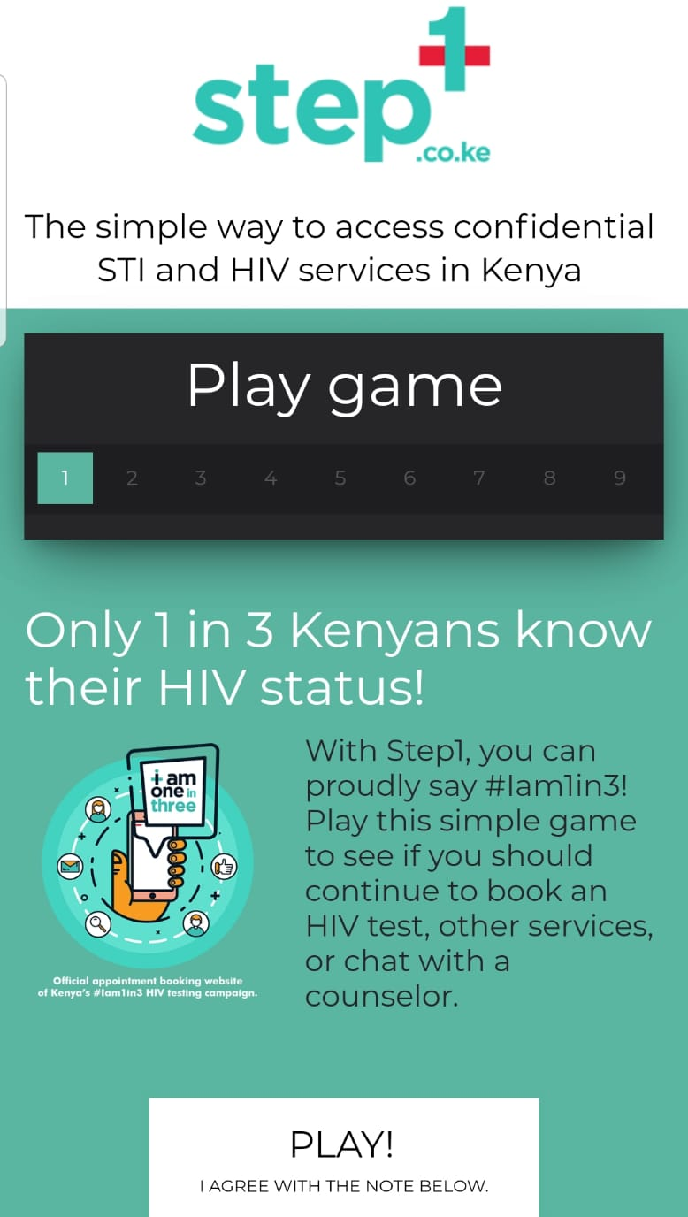
About the service delivery tool
With Step1, you can proudly say #iam1in3! Play a simple game to see if you should continue to book an HIV test, PrEP, ART, STI testing, STI treatment, or chat with a counselor. Clients can book services at 6 community drop-in centers and 6 private clinics offering a full range of HIV services in 4 cities (Nairobi, Nakuru, Kisumu, and Naivasha).
Try it now at mystep.one/test

Slide 4

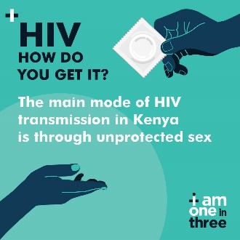
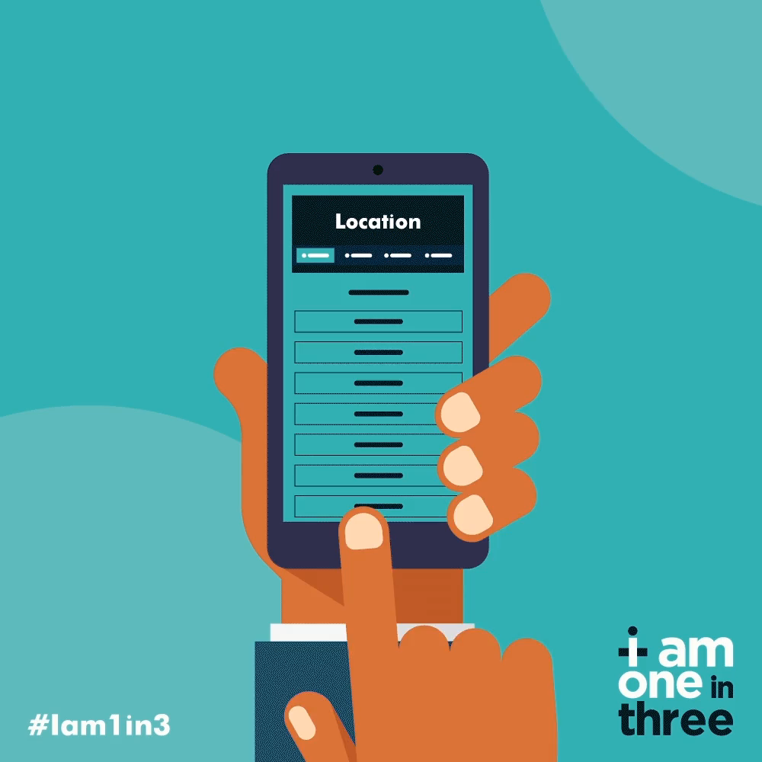

Rollout plan for Step1 and Iam1in3 campaign
Step1 was launched on March 10, 2019
General Campaign Strategy
Teaser: Generate hype about the campaign.
Reveal: Reveal 1 in 3 Kenyans know their HIV status and introduce Step1.
Sustain: Continued educational posts and re-targeting
Theme 1:
Reveal campaign and play game
Theme 2:
Awareness of risks
Theme 3:
Reduce barriers to testing
Theme 4:
Pills – ART and PrEP

Slide 5
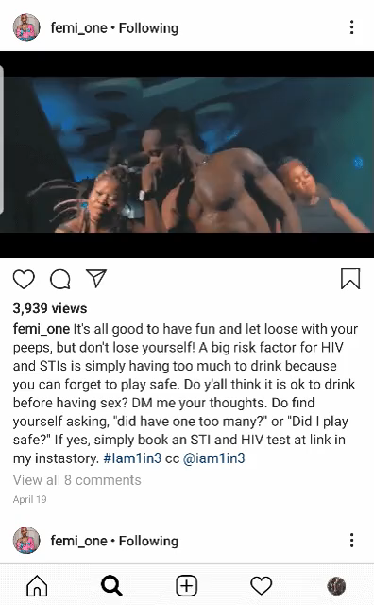
What Femi Does!
FemiOne is Nairobi’s BADA$$ rapper. She’s hard-core, urban, but charming. Her approach mixes her music promotion with messages that de-bunk HIV myths and update her followers on what they really need to know about HIV transmission, PrEP, and treatment (U=U).
Instagram @femi_one

Slide 6

What Seth Gor Does!
Seth Gor is an entertainer, vlogger, entrepreneur and instagrammer. He posts short comic videos to his 134K followers. His approach was to create IG posts and humorous videos about accessing services through Step1. Result?! 810 game plays from his first post!
Instagram @seth_gor

Slide 7
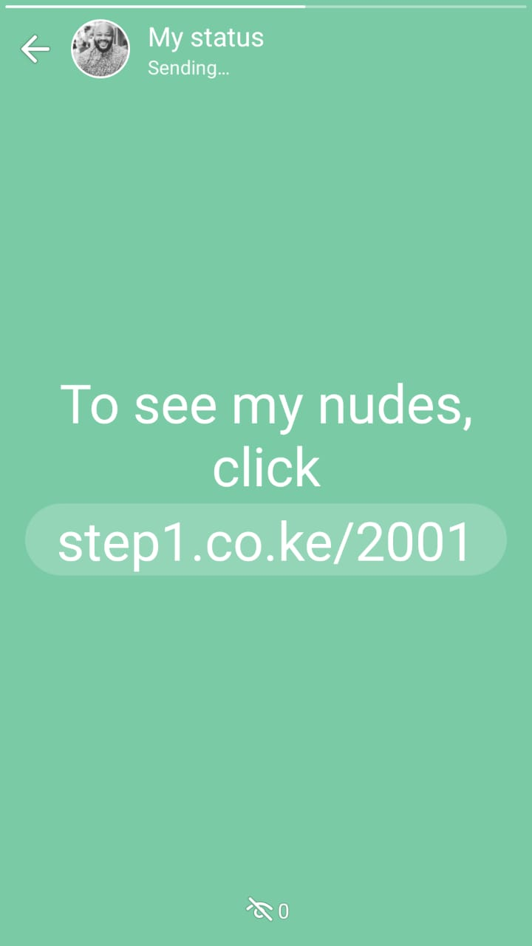
What Denis Does!
Denis Nzioka is an LGBTIQ and sex work activist. His focus was to engage the Kenyan LGBTIQ and sex work community to use Step1 with targeted, creative, ‘sexy’ words, pics, and posts.
Twitter @DenisNzioka

Slide 8
Results: Step1 HIV services cascade from online outreach
All Outreach Approaches | 11 March 2019 – 20 July 2019 (5158 game plays)
Key insights:
High # of game plays
Lower acceptability for booking services (9.7%)
Higher conversion between booking and arrival, supported by online outreach workers and counselors (41%)
Moderate HIV case finding (2.6%)
Few known PLHIV supported (N=3)
Low linkage to PrEP (14%)
Next steps:
New testing modalities (including self-testing and partner notification)
Change game to better support PLHIV
◆ % All appts/ risk assessments | ◆ % arrivals/ unique appts | ◆ % HIV case finding | ◆ % linked to treatment among newly diagnosed |  | ◆ STI case finding % | ◆ % of HIV negative linked to PrEP

Slide 9
Overall performance by week (HIV testing)
All Outreach Approaches | 11/03/2019 – 15/06/2019
MARCH
APRIL
MAY
JUNE
JULY
Key insights:
Low performance during training periods
High performance after training, standardizing role of outreach workers, and expansion to new cities in June
Next steps:
Maintain consistency of online outreach (ads, outreach workers, influencers)
Introduce performance-based incentives for outreach staff

Slide 10



HIV testing cascade by outreach approach
All outreach approaches compared 11 March 2019 - 20 July 2019
Results for each major online outreach approach
Results from each influencer
Key insights:
High uptake of HIV services resulting from community outreach staff
High reach among social media influencers for game plays, but few bookings/arrivals
Ads are re-targeted to clients who played the risk assessment
Next steps:
Use FB re-targeting to re-engage those originally reached by influencers
Use google ads to promote Step1 services online
# of game plays
578 | 2033 | 2145 | 402 | 344 | 227 | 1571
Notes:
Barbara – links for ORW and some influencers were not being tracked well in the beginning and some were coming in directly to the website.

Slide 11
Notable findings
Step1 clients are at high risk and uniquely reached online
  40% of risk assessments disclosing key population status
  47% of risk assessments disclosing HIV+ status are not taking treatment consistently, including not yet initiated and LTFU (N=278 PLHIV)
  70% clients tested for HIV through Step1 were not reached by CBO in past 6 months; 35% are first time testers
There remain challenges in client flow and service uptake
  Clients presented with “high or medium” HIV risk on game, are less likely to book an appointment than those of lower risk (B -0.428; p 0.49)
  Arrival rate drops when booking appointment far in future
  Target audience still getting used to the idea of booking HIV services

Slide 12

What clients think…
“I'm grateful for the way you handle people... Truly for the common good. Thank you.”
“The questions were asked in a way that was not intrusive or scary.”
“Quite positive. Gives me courage to want to know my status.”

Slide 13

My takeaways…
Convenience and influencer marketing:
Convenience of making a secure online booking to access services
Influencers can be great for establishing brand identity and developing trust among target audiences for sexual health services. They can boost results of other outreach approaches.
@DenisNzioka

Slide 14
Stay connected with LINKAGES
Follow LINKAGES on Twitter:
www.twitter.com/LINKAGES project
Like the project on Facebook:
www.facebook.com/LINKAGES project
Subscribe to the LINKAGES blog
www.linkagesproject.wordpress.com
Subscribe to The LINK, LINKAGES’s quarterly
project e-newsletter
Check out LINKAGES’s quarterly research digest

Slide 15






Acknowledgements
With special thanks to the LINKAGES/Kenya team managing Step1, (Barbara Thirikwa and Alice Olawo); the global technical support staff (Purvi Shah and Eric Stephan); and implementing CSOs MPEG, HOYMAS, KASH, MAAYGO, K-NOTE and NYDESO.

